Slide 1
K-Nearest Neighbours
Y.LAKHMI PRASAD
08978784848

Slide 2
Memory vs Learning
Memory is the process of recording, storing and retrieving information. In Memory, we keep the data and always go back to it whenever it is necessary.
Learning is the process or behavior of acquiring knowledge.
It is the ability to implement the information and make use of it in practical circumstances.

Slide 3
KNN – Different names
K-Nearest Neighbors
Memory-Based Reasoning
Example-Based Reasoning
Instance-Based Learning
Case-Based Reasoning
Lazy Learning

Slide 4
Introduction to KNN
KNN is a simple yet powerful classification algorithm.
It requires no training for making predictions, which is typically one of the most difficult parts of a machine learning algorithm.
The KNN algorithm have been widely used to find document similarity and pattern recognition
Lazy learner
Instance Based
Lazy because it does not try to learn a function from the training data.
It memorise the pattern from the dataset
Nonparametric model

Slide 5
KNN's Idea
The intuition behind the KNN algorithm is one of the simplest of all the supervised machine learning algorithms.
It simply calculates the distance of a new data point to all other training data points.
The distance can be of any type e.g Euclidean or Manhattan etc.
It then selects the K-nearest data points, where K can be any integer.
Finally it assigns the data point to the class to which the majority of the K data points belong.

Slide 6
Nearest Neighbor Classifiers
Basic idea:
If it walks like a duck, quacks like a duck, then it’s probably a duck.
Compute Distance
Test Record
Training Records
Choose k of the “nearest” records

Slide 7
K-Nearest Neighbor
K-Nearest neighbor is a simple algorithm that stores all available cases and classifies new cases by a majority vote of its k neighbors.
This algorithm segregates unlabeled data points into well-defined groups.

Slide 8
K - Nearest Neighbors
For a given instance ‘T’, get the top “K” dataset instances that are “nearest” to ‘T’.
Inspect the category of these “K” instances, choose the category “C” that represent the most instances.
Conclude that ‘T’ belongs to category “C”.

Slide 9
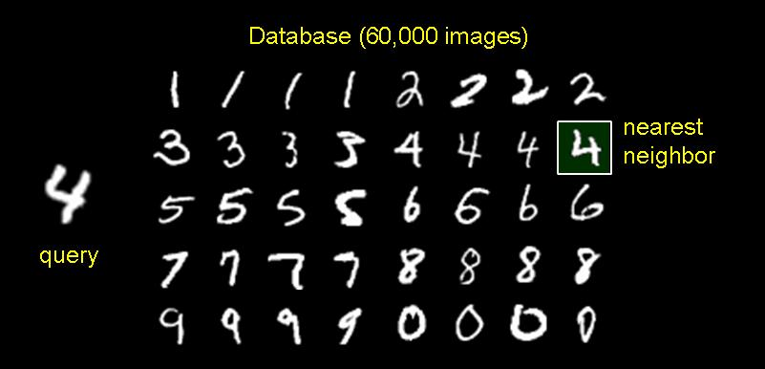
1-Nearest Neighbor Classifier
Training Examples (Instances)
Some for each CLASS
Test Examples
(What class to assign this?)

Slide 10
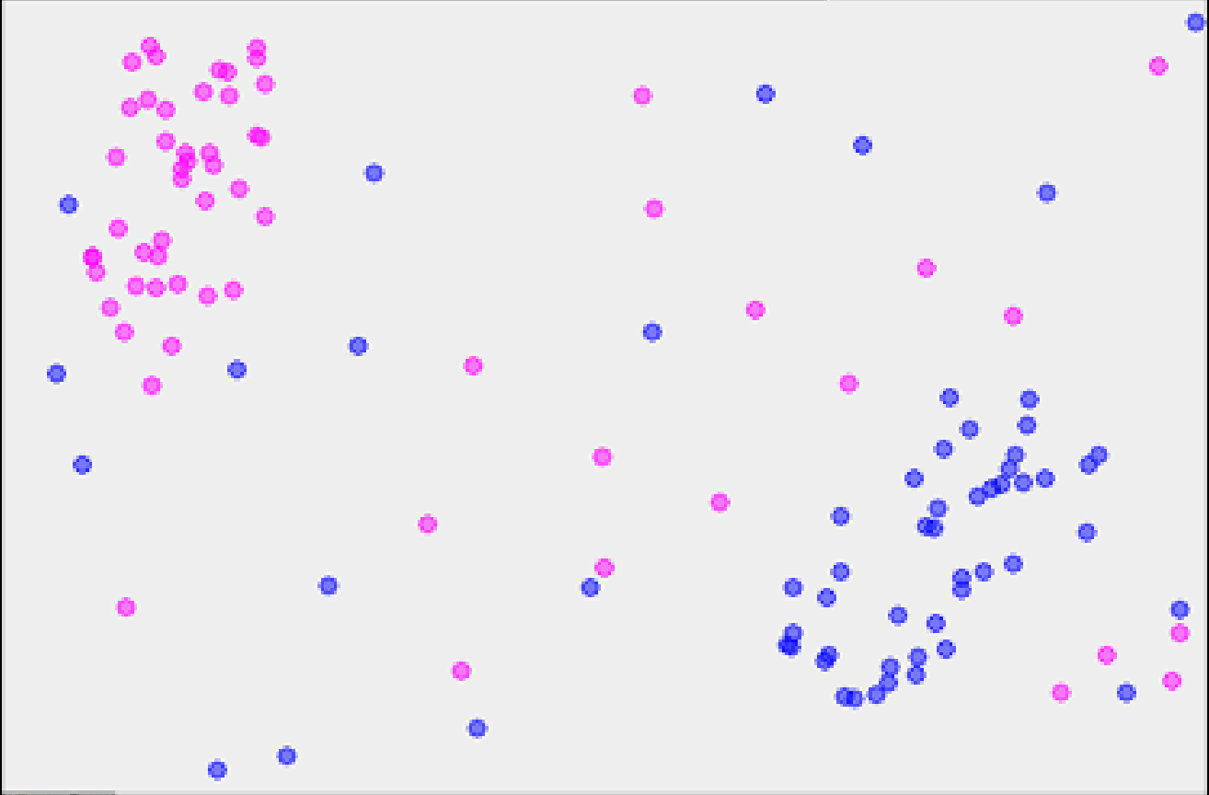
1-Nearest Neighbor
x

Slide 11
2-Nearest Neighbor
?

Slide 12
3-Nearest Neighbor
X

Slide 13
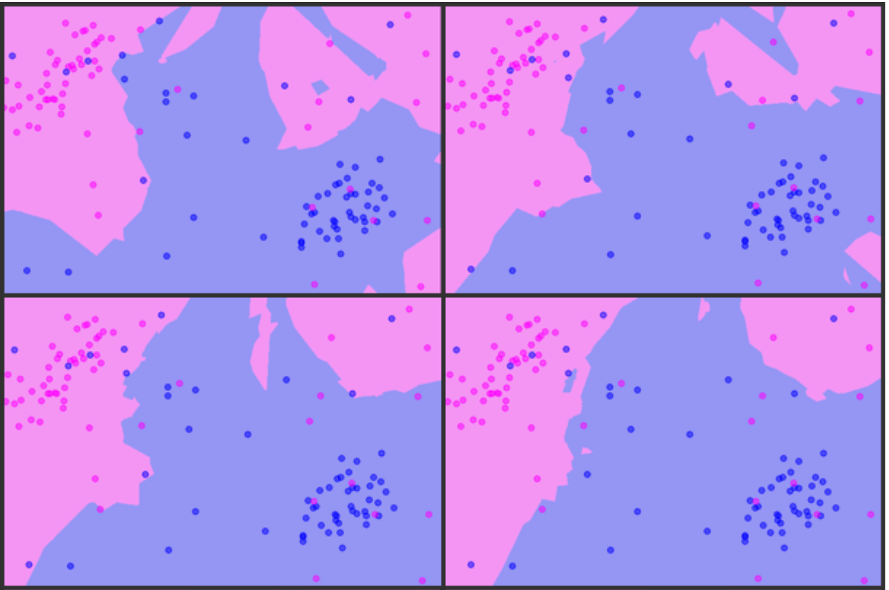
K = 3, 5, 7, 9

Slide 14
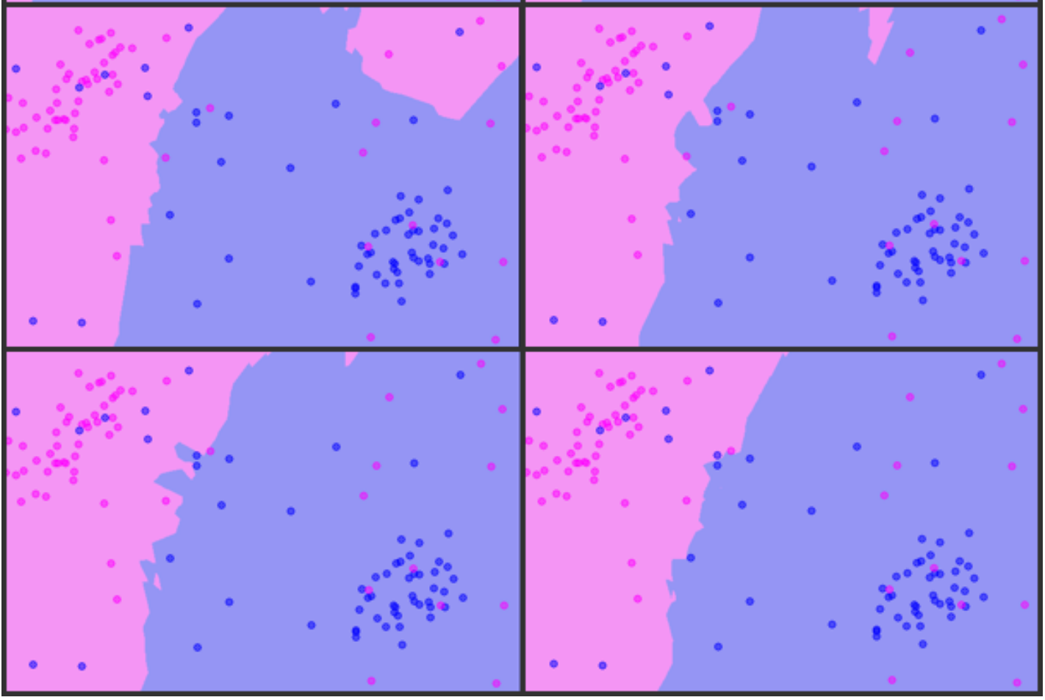
K = 11,13,15,17

Slide 15
Choosing The K
Choosing the number of nearest neighbors i.e. determining the value of ‘K’ plays a significant role in determining the efficacy of the model.
A large k value has benefits which include reducing the variance due to the noisy data, the side effect being developing a bias due to which the learner tends to ignore the smaller patterns which may have useful insights.

Slide 16
Model complexity:
K has general name. It is called a hyper-parameter. For now just know K is hyper-parameter and we need to choose it that gives best performance.
If k is small, model is complex model can lead to overfit. It means that model memorizes the train sets and cannot predict test set with good accuracy.
If k is big, model that is less complex model can lead to under-fit.

Slide 17
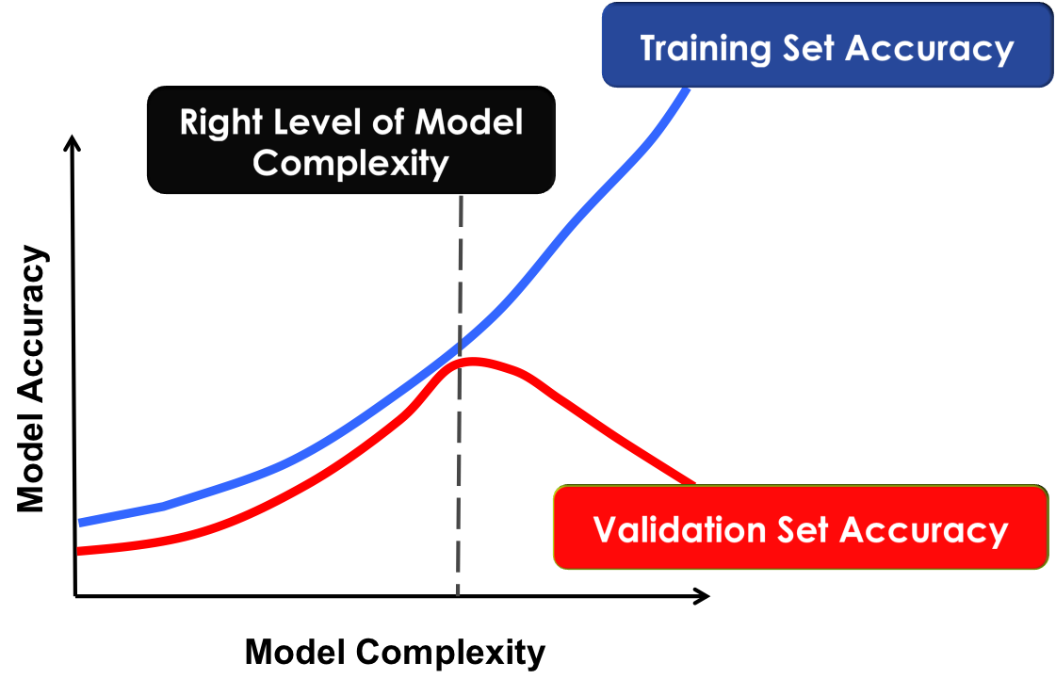
Controlling Complexity in KNN

Slide 18
K - Nearest Neighbors
Requires three things
1. The set of stored records
2. Distance Metric to compute distance between records
3. The value of ‘K’, the number of nearest neighbors to retrieve

Slide 19
K - Nearest Neighbors
To classify an unknown record:
1. Compute distance to other training records
2. Identify k nearest neighbors
3. Use class labels of nearest neighbors to determine the class label of unknown record (e.g., by taking majority vote)

Slide 20
Which distance Metric to use?
When you have Numeric variables we use Euclidean distance, When you have Categorical variables we use Hamming distance.

Slide 21
Nearest Neighbor Classification
Compute distance between two points:
Euclidean distance
Determine the class from nearest neighbor list
Take the majority vote of class labels among the k-nearest neighbors
Weigh the vote according to distance
weight factor, w = 1/d²

Slide 22
Nearest Neighbor Classification
MinKowski
1. Euclidean (P=2)
2. Manhatten (P=1)
3. Hamming (P=0)
4. Chebyshev (P=Inf)

Slide 23
Euclidean distance:
Most common
L2 norm of two vectors.
In a bidimensional plane, the Euclidean distance refigures as the straight line connecting two points, and you calculate it as the square root of the sum of the squared difference between the elements of two vectors.
The Euclidean distance between points (1,2) and (3,3) can be computed which results in a distance of about 2.236.

Slide 24
Manhattan distance
Another useful measure is the Manhattan distance
L1 norm of two vectors
Summing the absolute value of the difference between the elements of the vectors.
If the Euclidean distance marks the shortest route, the Manhattan distance marks the longest route, resembling the directions of a taxi moving in a city. (The distance is also known as taxicab or city-block distance.)
For instance, the Manhattan distance between points (1,2) and (3,3) is abs(1–3) and abs(2–3), which results in 3.

Slide 25
Chebyshev distance
Takes the maximum of the absolute difference between the elements of the vectors.
It is a distance measure that can represent how a king moves in the game of chess or, in warehouse logistics, the operations required by an overhead crane to move a crate from one place to another.
In machine learning, the Chebyshev distance can prove useful when you have many dimensions to consider and most of them are just irrelevant or redundant (in Chebyshev, you just pick the one whose absolute difference is the largest).
In the example used in previous sections, the distance is simply 2, the max between abs(1–3) and abs(2–3).

Slide 26
Pros of KNN
Advantages:
Analytically tractable, simple implementation.
Uses local information, which can yield highly adaptive behaviour.
It is extremely easy to implement
It is lazy learning algorithm and therefore requires no training prior to making real time predictions. This makes the KNN algorithm much faster than other algorithms that require training e.g SVM, linear regression, etc.
Since the algorithm requires no training before making predictions, new data can be added seamlessly.
There are only two Hyperparameters required to implement KNN i.e. the value of K and the distance function (e.g. Euclidean or Manhattan etc.)

Slide 27
Cons of KNN
Disadvantages:
Large storage requirements
Computationally intensive recall
The KNN algorithm doesn't work well with high dimensional data because with large number of dimensions, it becomes difficult for the algorithm to calculate distance in each dimension.
The KNN algorithm has a high prediction cost for large datasets. This is because in large datasets the cost of calculating distance between new point and each existing point becomes higher.
The KNN algorithm doesn't work well with categorical features since it is difficult to find the distance between dimensions with categorical features.

Slide 28
Applications
Currency exchange rate
Bank bankruptcies
Understanding and managing financial risk
Credit rating
Loan management
Bank customer profiling
Money laundering analyses
Predict cancer is malignant or benign
Pattern recognition
Recommender Systems
Computer Vision
Gene Expression
Protein-Protein Interaction and 3D Structure Prediction

Slide 29
Summary
KNN is conceptually simple, yet able to solve complex problems
Can work with relatively little information
Learning is simple (no learning at all!)
Consider the Memory and CPU cost
Feature selection problem

Slide 30
Questions?

